Slide 2
Types of statistical analysis: Descriptive and Inferential statistics
Descriptive statistics
Summarizes the data in terms of center point, dispersion, and distribution.
Central tendency: Locating the centre point (mean, mode, median)
Dispersion: The spread in terms of smallest values to the largest (variability).
Distribution: the spread of the data in terms of symmetry, skewed, peaked, flat, etc.
Inferential statistics
Estimate population parameters.
Compare significant difference between two or more population.
Tests for relationship between variables to make prediction.

Slide 3
Inferential statistics
Inferential statistics can be used to prove or disprove theories, determine associations between variables, and determine if findings are significant and whether or not we can generalize from our sample to the entire population.
Some of the examples of inferential statistical tools:
z score, confidence interval, sampling distribution,
T-tests/ANOVA
Mann Whitney test
Chi-square and etc.

Slide 4
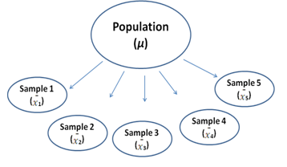
Estimation & Sampling Distribution
Statistical inference?
Statistical inference is about making conclusions on population parameters using sample statistics

Slide 5
Standard error of the mean

Slide 6
Example 1
Department of roads wants to build low noise road. To do so, recycled rubber can be added to asphalt mixture to reduce road noise. Calculation showed that a viscosity of 3200 is required. Therefore it is determined that mean viscosity of the asphalt mixture (population mean) and standard deviation is are (µ) = 3200 and (σ) = 150.
During the manufacture of each batch of asphalt (this is a population) the quality control specialist takes 15 specimen of the material and tests the viscosity.

Slide 7
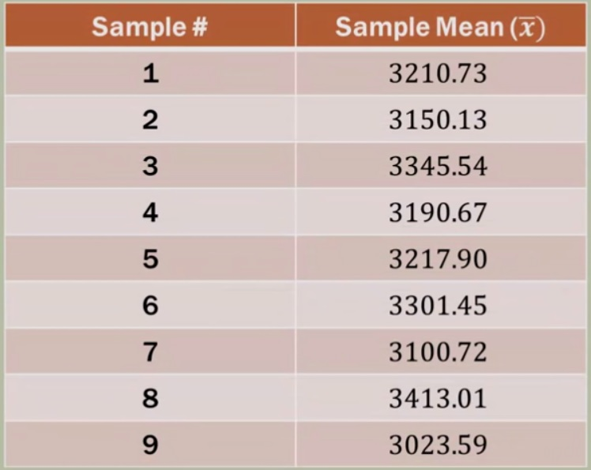
Sample size (9 sample of 15 measurements each)
Mean of 15 specimen measurements

Slide 8
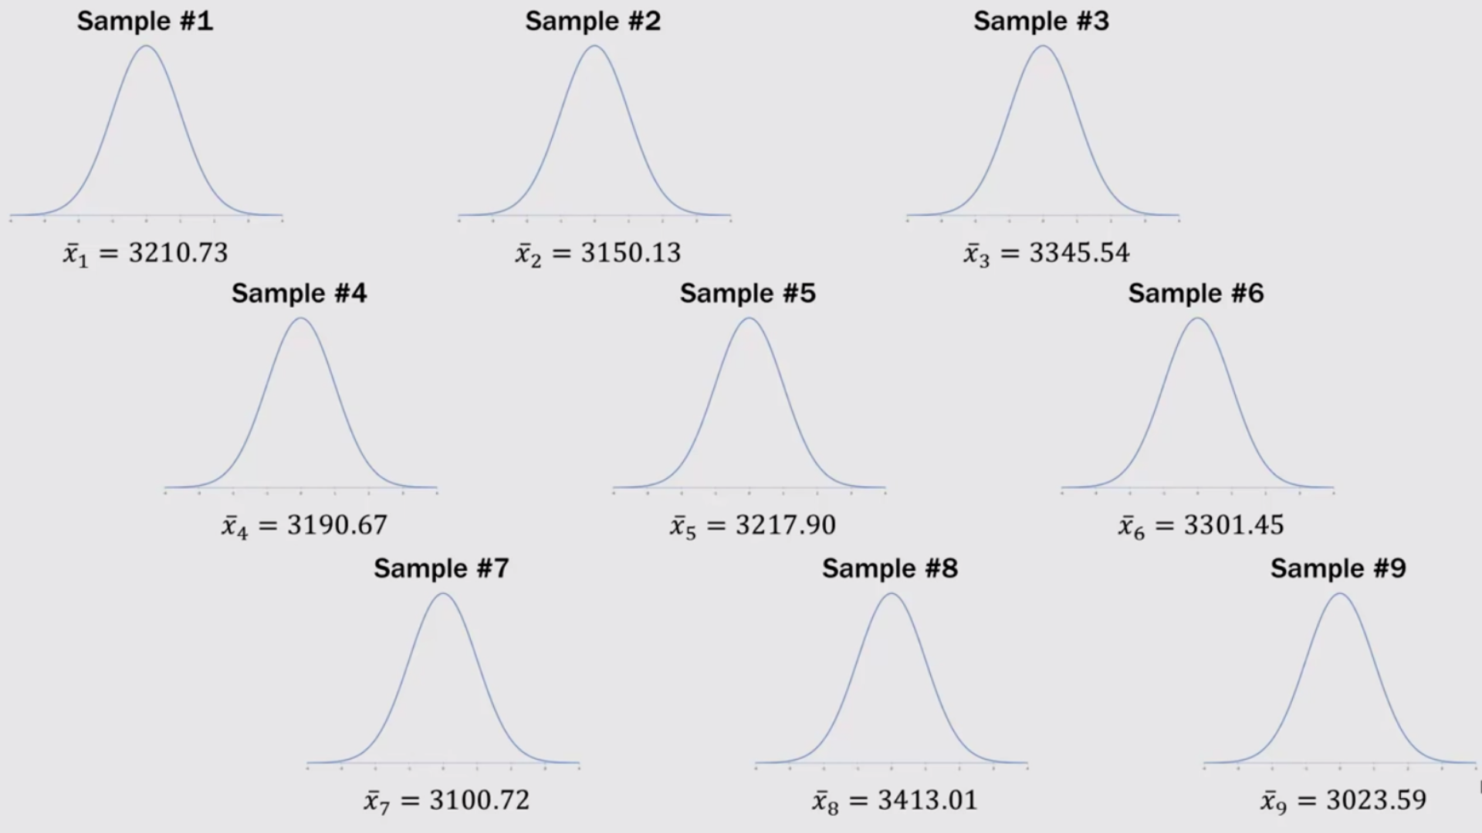
Distribution curve for each sample

Slide 9
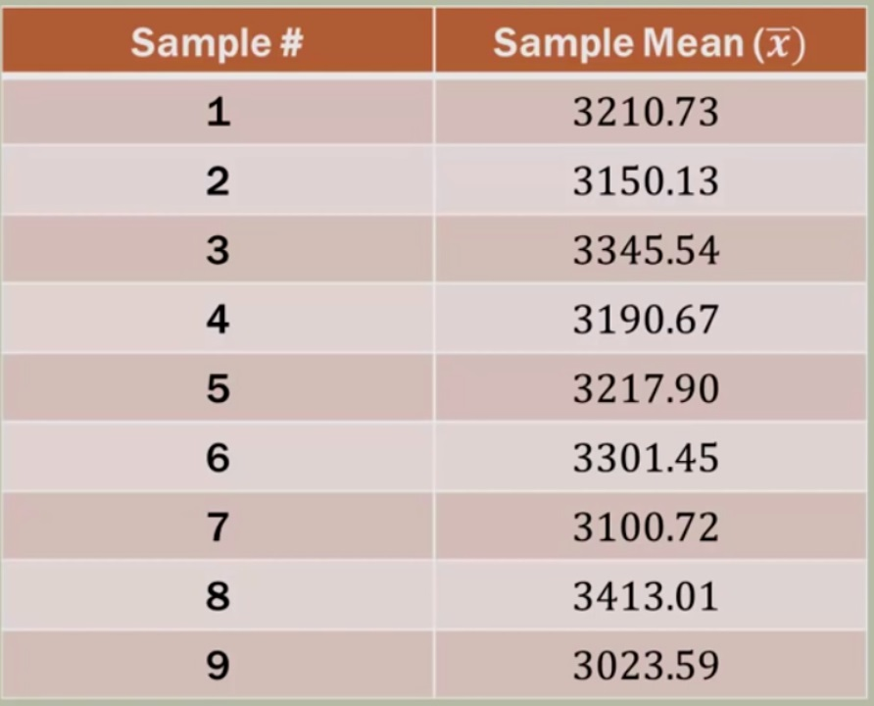

Create a class interval of given range (class size) and plot a frequency graph
Frequency

Slide 10
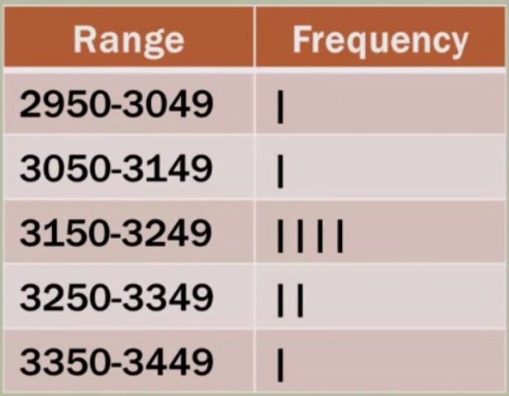
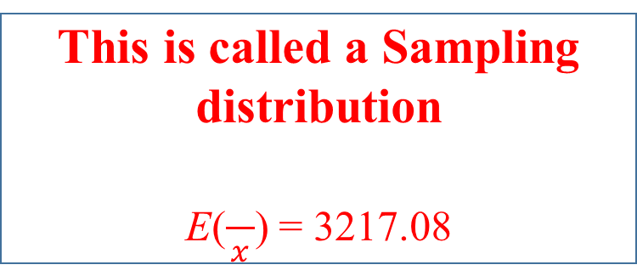
This is called a Sampling distribution
E($\frac{}{x}$) = 3217.08

Slide 11
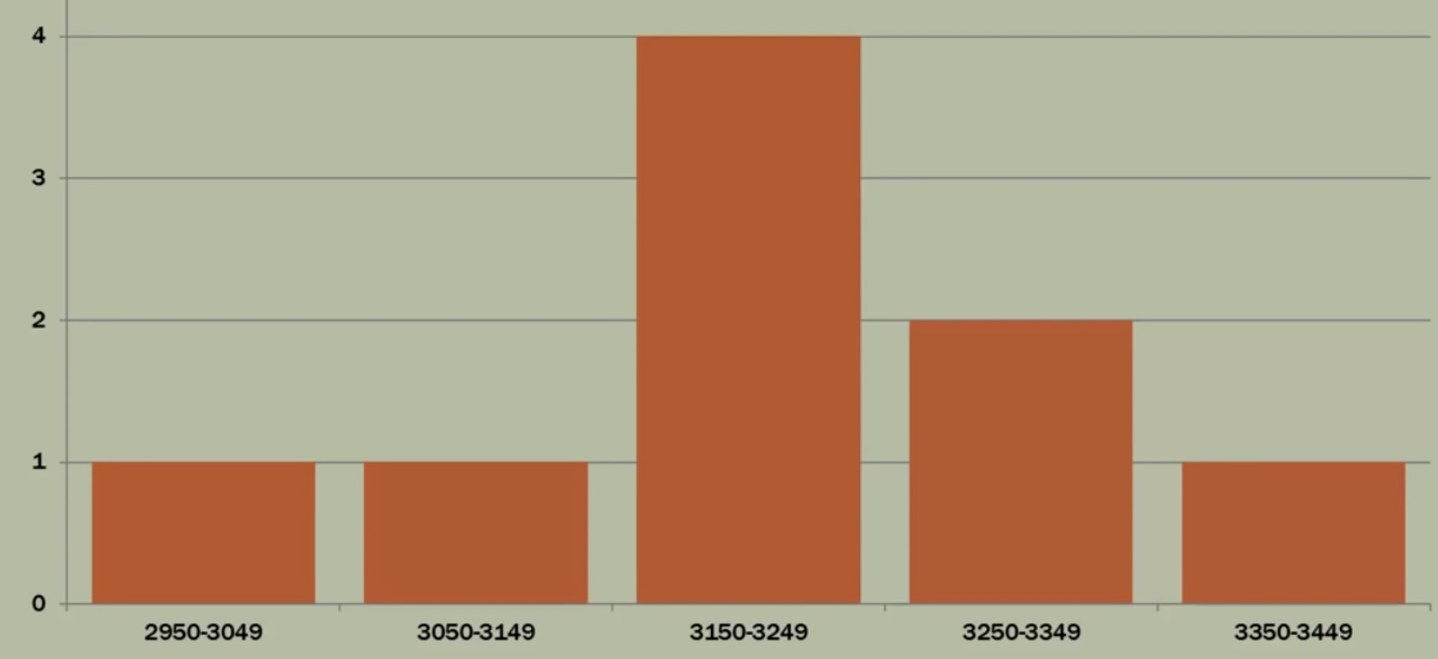

Slide 12
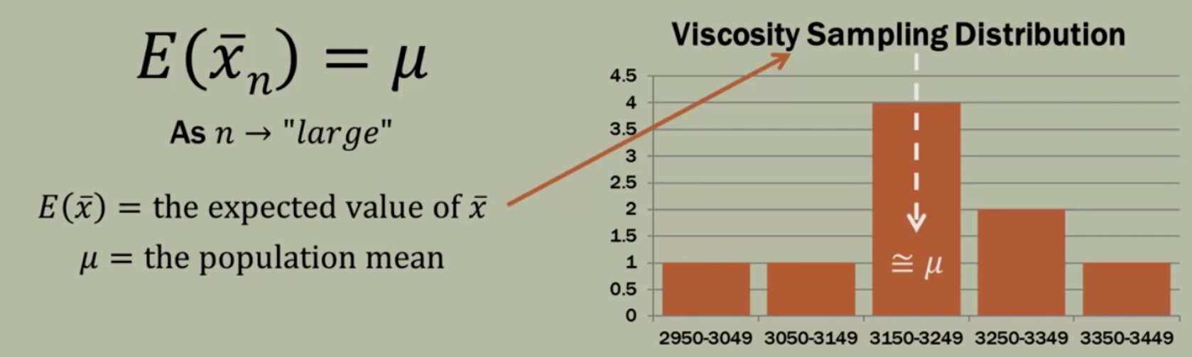

The expected value (mean) of $\frac{}{x}$
Note: if many random samples are taken from a population each with its own sample mean and then create a distribution, the mean of that sampling distribution is equal to the mean of the population

Slide 13
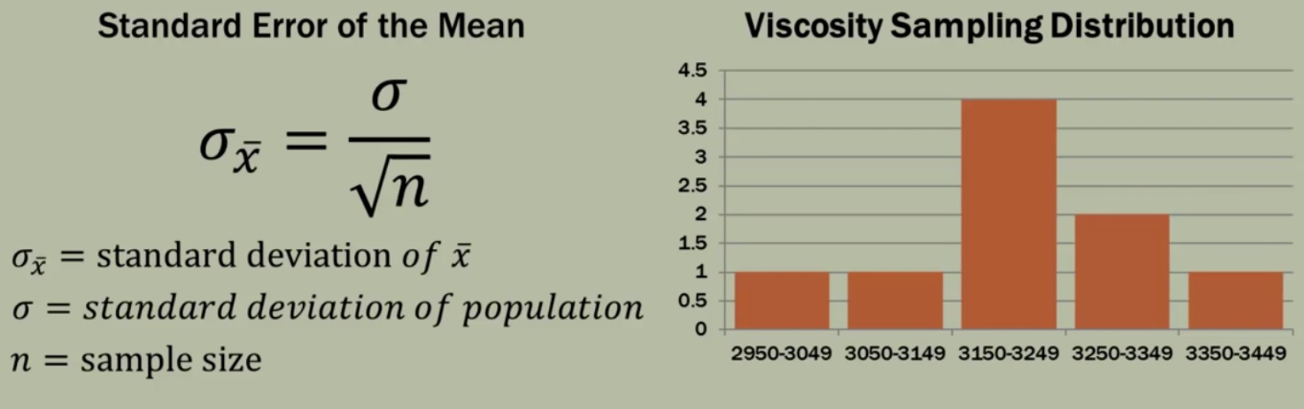
Standard deviation of a sampling distribution: Standard error of the mean

Slide 14
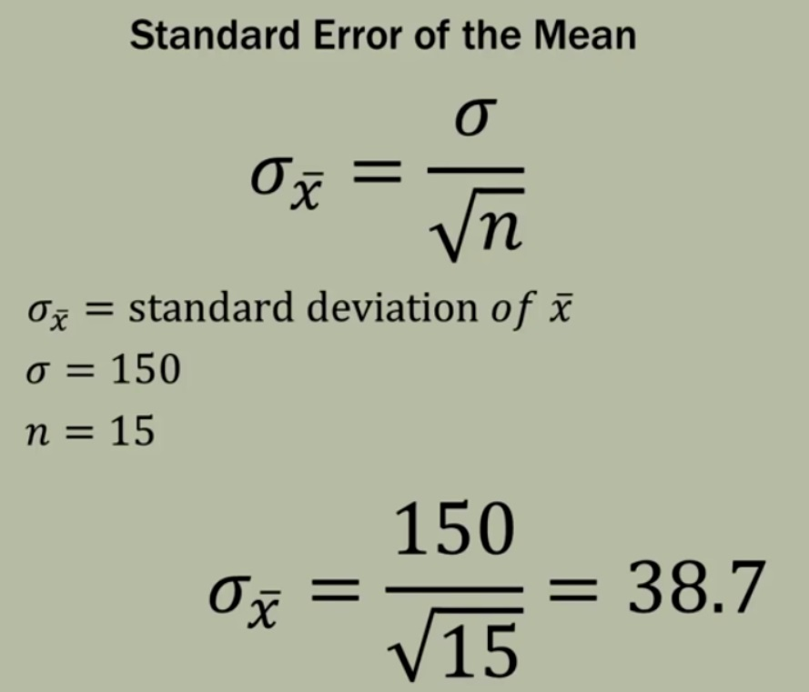

Slide 15
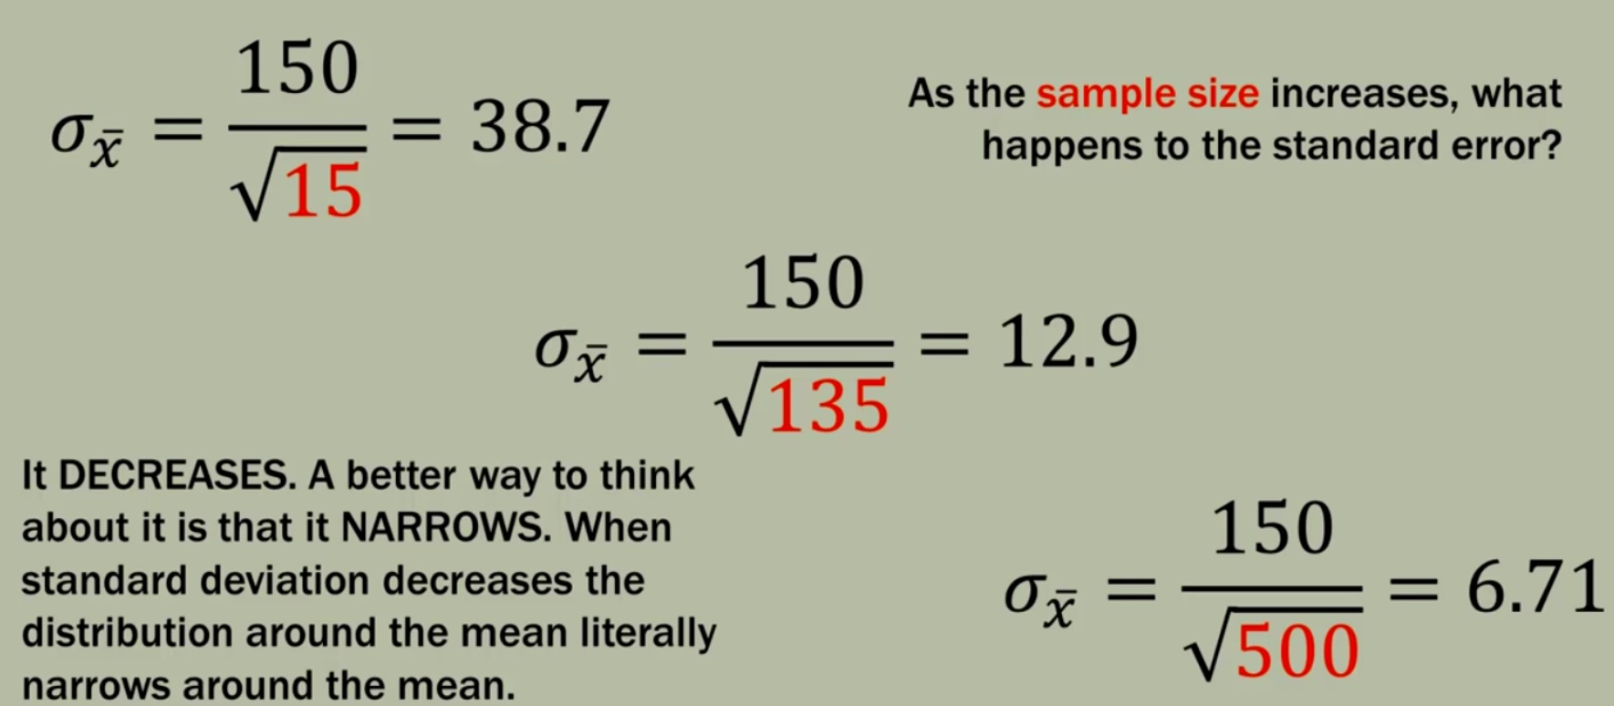
Influence of sample size to Standard Error of the Mean (SEM)

Slide 16
